Slide 1
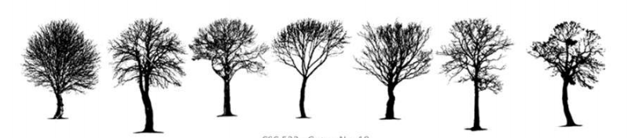
FOREST COVER TYPE PREDICTION
A Multiclass Classification Problem based on Cartographic Data(Forest Cover)

Slide 2
CARTOGRAPHIC VARIABLES:
Graphically representing a geographical area w.r.t (position, size, shape,value, color, orientation, and texture)
Cartography- The study and practice of making maps.
Given:
The Actual forest cover type form a given observation (30 x 30 meter cell) was determined from US Forest Service (USFS) Region 2 Resource Information System (RIS) data.
Independent variables were derived from data originally obtained from US Geological Survey (USGS) and USFS data.

Slide 3
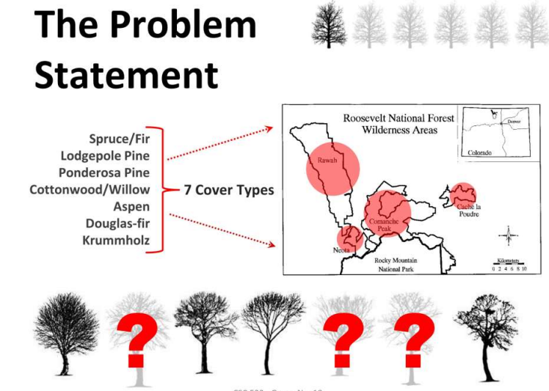

Slide 4
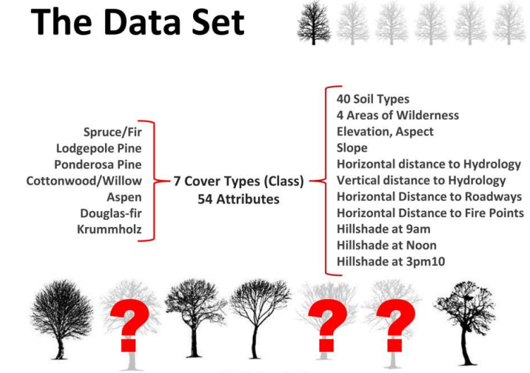

Slide 5
UNDERLYING FACTS ABOUT DATASET :
Data collected from Roosevelt National Forest, located in the Front Range of Northern Colorado.
In this Data-Set we are Classifying the forest covers(Predominant kind of tree cover) into 7 cover types with the help of Cartographic variables.
Data Shape: (581012, 13)
Data has 4 different types of Wilderness Areas:
Cache La Poudre Wilderness, 14.47 square miles
Comanche Peak Wilderness, 104.4 square miles
Neota Wilderness, 15.51 square miles (partly in Routt NF)
Rawah Wilderness, 119.4 square miles (partly in Routt NF)

Slide 6
BUSINESS PROBLEM
Original Owners of Database: Department of Forest Sciences,College of Natural Resources,Colorado State University, Fort Collins, CO 80523 - created for geographical study during their research projects.
As per the data given there was no business problem associated to it . So we researched about the different forest cover types having different types of trees present there and tried to fit a business problem with them . The best industry to which we can associate is medicine(pharma companies) as they generally need different plant extracts for making different types of medicines.

Slide 7
FOCUS CLASSES
Through our research we found out that trees present in 4 out of 7 forest cover types plays crucial role in the manufacturing of medicines. These are as follows:
Aspen(forest cover type 5): The bark and leaf are used to make medicines which are used in the treatment for Joint Pain,Nerve Pain,Bladder problem and Prostate Discomfort.
Douglas-fir (Forest cover type 6): The trunk of this tree is used in the manufacturing of medicines which treat Burns, Wound, Skin Ailments.
Spruce/fir (type 1): This tree is used in the manufacturing medicines which treat Swelling, Muscle pain, Arthritis, Tuberculosis, Bronchitis.
Cottonwood/willow (type 4): Leaf buds of this tree have anti-inflammatory,antifungal,antimicrobial properties which can be used in the treatment of variety of skin diseases, and also in the treatment of fever.

Slide 8
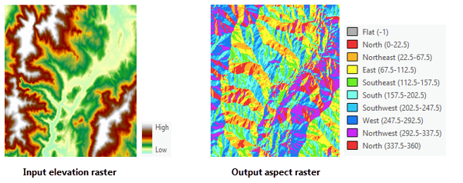
Data Description-
Elevation-
It is a quantitative feature measured in meters. An elevation is a rise or the raising of something. Mountains have an elevation based on how high they are.
Aspect
Aspect is the compass direction that a slope faces.
Slope
It is a quantitative feature measured in degrees. Slope is essentially the gradient or incline of the land

Slide 9
Horizontal Distance to Hydrology
It is a quantitative feature measured in meters. It is the horizontal distance to the nearest surface water source.
Vertical Distance to Hydrology
It is a quantitative feature measured in meters. It is the vertical distance to the nearest surface water source.
Horizontal Distance to Roadways
It is a quantitative feature measured in meters. It is the horizontal distance to the nearest roadway.
Horizontal Distance to Firepoints
It is a quantitative feature measured in meters. It is the horizontal distance to the nearest wildfire ignition points

Slide 10
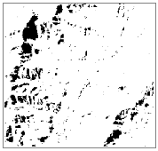
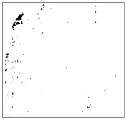
Hillshade 9 AM
It is a quantitative feature measured in 0 – 255 index. A hillshade is a grayscale 3D representation of the surface, with the sun's relative position taken into account for shading the image. This function uses the altitude and azimuth properties to specify the sun's position. It is a Hillshade index at 9am, summer solstice.
Hillshade Noon
It is a quantitative feature measured in 0 – 255 index. It is a Hillshade index at noon, summer solstice
Hillshade 3 PM
It is a quantitative feature measured in 0 – 255 index. It is a Hillshade index at 3pm, summer solstice
.
With Low Sun Angle
With High Sun Angle

Slide 11
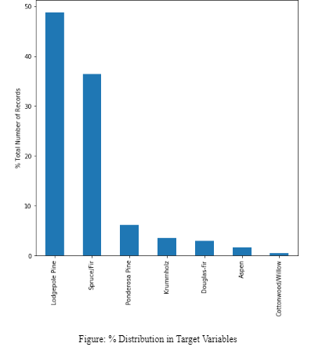
EXPLORATORY DATA ANALYSIS
This plot shows Percentage distribution of Forest cover type-
Lodgepole Pine 48.759922
Spruce/Fir 36.460521
Ponderosa Pine 6.153746
Krummholz 3.530048
Douglas Fir 2.989095
Asphen 1.633873
Cottonwood/Willow 0.472796

Slide 12
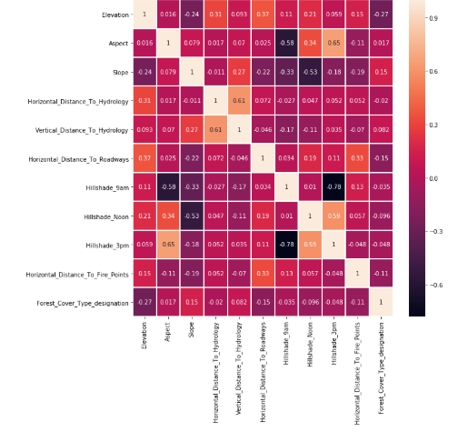
EXPLORATORY DATA ANALYSIS
Heatmap is a correlation plot which tells us about correlation among continuous variables.
Highest correlation with Forest Cover Type is with Elevation (shows Elevation might be a good predictor).
Other two good predictors are Horizontal_Distance_To_Roadways and Slope.
Strong correlation between Hillshade 9 pm and 3 pm, Slope and Hillshade noon, Aspect and Hillshade 9am,Horizontal and Vertical Distance to Hydrology.

Slide 13
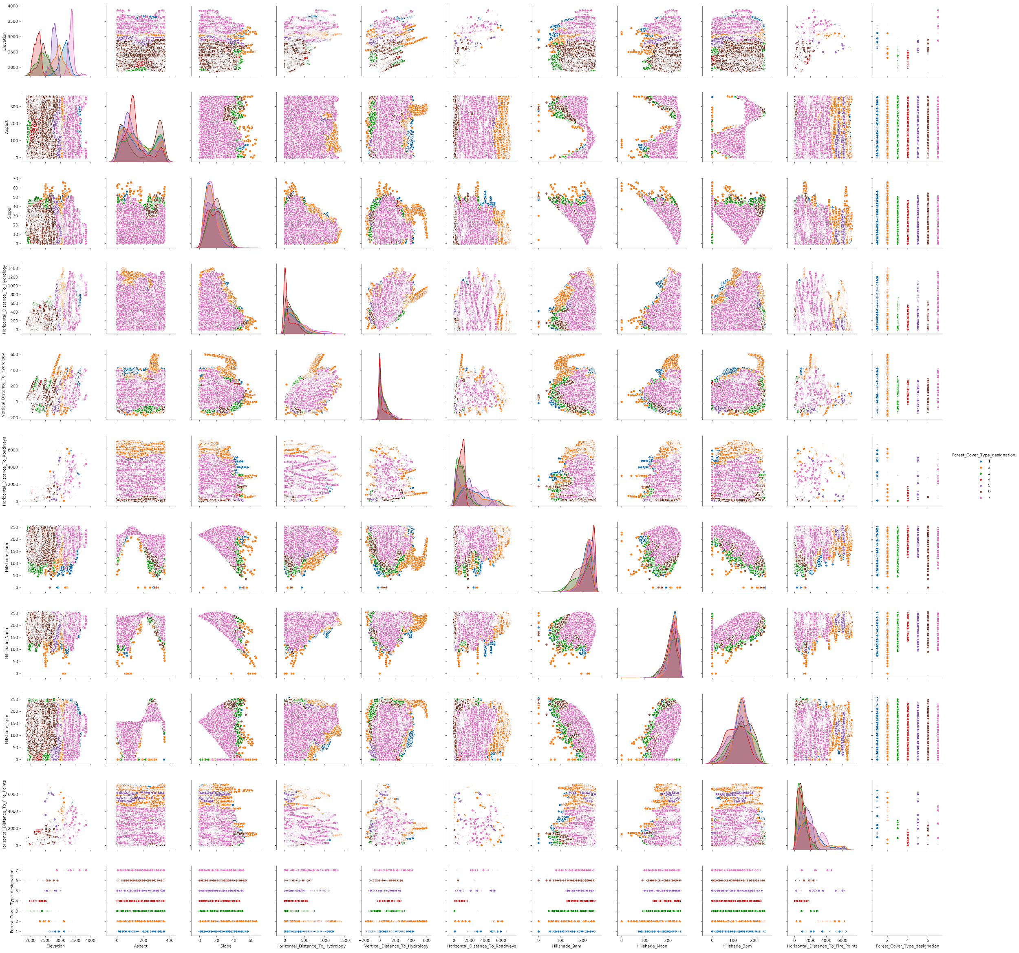
We are able to see a lot of Axis Parallel Boundary patterns among many combinations of numerical variables across different Forest Cover Types evidently with Elevation.
Also, the horizontal & vertical distances are showing noisy patterns which might require our attention to train our models in the future.

Slide 14
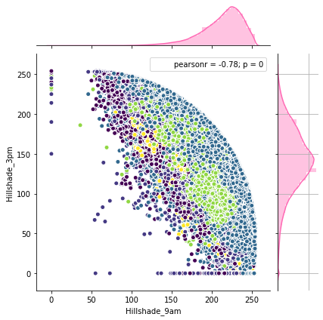
EXPLORATORY DATA ANALYSIS
This is a Scatter Plot of Hillshade Indexes-
The value of Hillshade Indexes are between 0 to 255.
Feature Hillshade_3pm contains many zeros.
If there was shade at 9 AM and Noon then it is very obvious to expect that there will be little shade at 3PM.

Slide 15
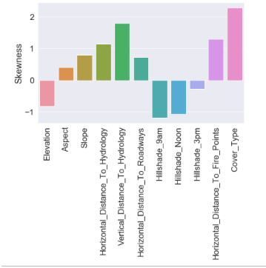
EXPLORATORY DATA ANALYSIS
This plot shows the skewness (Positive or Negative) for various features in Descending Order -
The Positive skewed features are-Vertical Distance to Hydrology, Vertical Distance to Firepoint, Horizontal Distance to Hydrology,Slope,Distance to Roadways,Aspect.
The Negative skewed features are - Hillshade 9am,Hillshade noon,Elevation,Hillshade 3pm.

Slide 16
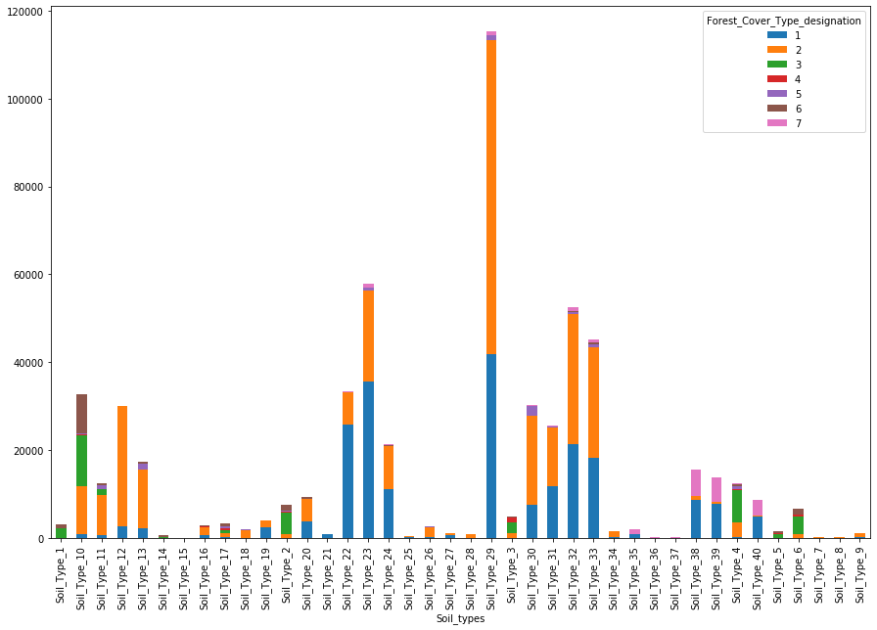
SOIL TYPE AND FOREST COVER TYPE

Slide 17
SOIL TYPE AND FOREST COVER TYPE
Pattern found in the types of forest covers occurring together.
Soil Type 1, 5, 6, 14 only support forest covers 3, 4 and 6
Soil Type 8, 9, 12, 18, 21, 22, 25, 26, 27, 28, 29, 30, 35, 36, 37, 38, 39, 40 support combination of forest covers 1, 2, 5 and 7.

Slide 18
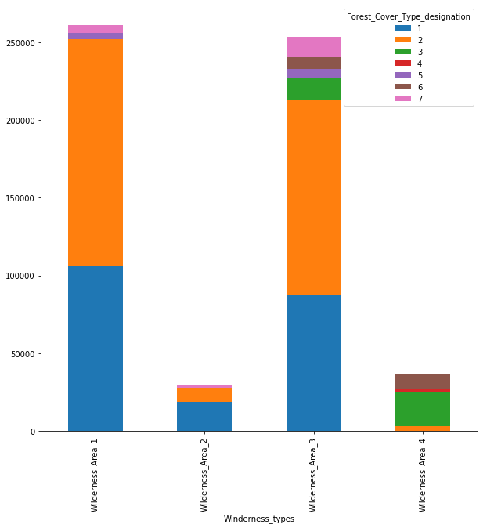
WILDERNESS TYPE AND FOREST COVER TYPE
Forest cover type 4 is found only in Wilderness Area 4.
Forest cover type 3 and 6 can only be found in Wilderness Area 3 and 4.

Slide 19
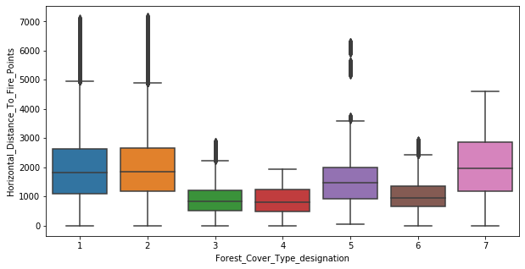
HORIZONTAL DISTANCE TO FIRE POINT AND FOREST COVER TYPE
Forest covers type 3, 4 and 6 show similar distribution to each other while Forest cover type 1, 2, 5, 7 show highly overlapping distribution.

Slide 20
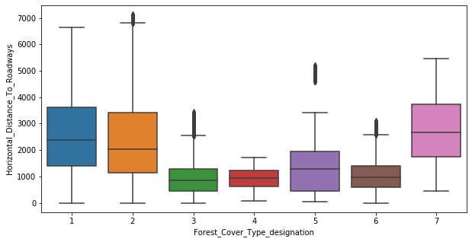
HORIZONTAL DISTANCE TO ROADWAYS V/S FOREST COVER TYPE
Forest covers type 3, 4 and 6 show similar distribution to each other while Forest cover type 1, 2 and 7 show highly overlapping distribution.

Slide 21
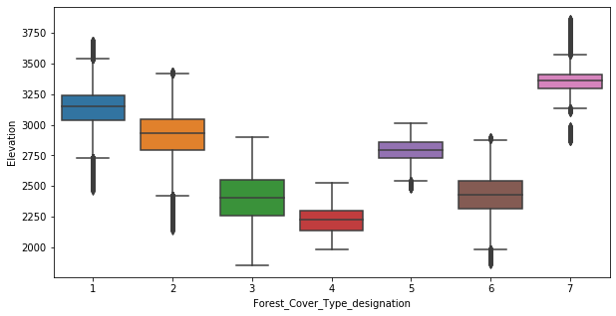
ELEVATION V/S FOREST COVER TYPE
Significant distinction found in the distribution of the different forest cover types.

Slide 22
Statistical Analysis
Categorical vs Categorical Analysis - Chi Square Test
 | Variable 1 | Variable 2 | Result | Cramer's Corrected Value
Chi Square Test of Association & Cramer's Corrected Value | Winderness_types | Forest_Cover_Type_designation | Dependency Found | 0.443
 | Soil_types | Forest_Cover_Type_designation | Dependency Found | 0.467
 | Winderness_types | Soil_types | Dependency Found | 0.685
Cramer's V Corrected value is a measure of Chi Square Association Statistic which has been employed to quantify the amount of dependency among Categorical Features ranging from 0 to 1.

Slide 23
Statistical Analysis
Categorical vs Continuous Analysis - ANOVA
Variable 1 | Variable 2 | Result
Elevation | Forest_Cover_Type_designation | Unequal means
Aspect | Forest_Cover_Type_designation | Unequal means
Slope | Forest_Cover_Type_designation | Unequal means
Horizontal_Distance_To_Hydrology | Forest_Cover_Type_designation | Unequal means
Vertical_Distance_To_Hydrology | Forest_Cover_Type_designation | Unequal means

Slide 24
Statistical Analysis
Categorical vs Continuous Analysis - ANOVA
Variable 1 | Variable 2 | Result
Horizontal_Distance_To_Roadways | Forest_Cover_Type_designation | Unequal means
Hillshade_9am | Forest_Cover_Type_designation | Unequal means
Hillshade_Noon | Forest_Cover_Type_designation | Unequal means
Hillshade_3pm | Forest_Cover_Type_designation | Unequal means
Horizontal_Distance_To_Fire_Points | Forest_Cover_Type_designation | Unequal means

Slide 25
Statistical Analysis
Categorical vs Continuous Analysis - Post Hoc Analysis
AIM: To do Post Hoc Analysis using Pairwise Tukey HSD Test.
Results:
Statistically all the combinations of Forest_Cover_Type_designation are acting as distinct distributions w.r.t each other for Elevation, Slope, Hillshade_3pm, Hillshade_9am & Hillshade_Noon making them a very good predictor for our analysis.
Statistically all the combinations except 2-7, 4-5 of Forest_Cover_Type_designation are acting as distinct distributions w.r.t each other for Aspect , 1-4, 2-6 for Vertical_Distance_To_Hydrology, 3-5 for Horizontal_Distance_To_Hydrology, 3-4 for Horizontal_Distance_To_Roadways, 3-4 for Horizontal_Distance_To_Fire_Points.

Slide 26
Checking Multicollinearity
After Applying evaluating Variance Inflation Factor to our Dataset, we found that the following features were having VIF more than threshold as 5.
'Hillshade_Noon'
'Elevation'
'Hillshade_9am'
'Hillshade_3pm'
‘Slope’

Slide 27
BUT...
- According to our Exploratory Data Analysis, Elevation is definitely a good predictor of Forest Cover Types. So, even though Variance Inflation Factor shows that we should drop it but we will not be dropping it on the basis of Domain knowledge and our EDA as mentioned in the Description of UCI Repository
- As far as Hillshade Indexes are concerned, there was definitely a very high correlation among those 3 independent variables in the heatmap also and they are also multicollinear in nature. Therefore, we will be reducing them down to one variable which can be either a combination(of two) of their products or there means.
- As far as Slope is concerned it is a very good predictor as well but since it is showing multicollinearity that's probably because slope and aspect are both in degrees. Therefore, there might be some interaction among the two variables. So, we will take a cosine of the slope on the basis of domain knowledge.

Slide 28
INITIAL APPROACH

Slide 29
Base Model
precision recall f1-score support
1 0.68 0.71 0.69 42333
2 0.74 0.77 0.76 56732
3 0.70 0.77 0.73 7058
4 0.57 0.62 0.59 595
5 0.48 0.20 0.29 1875
6 0.56 0.21 0.30 3503
7 0.76 0.38 0.51 4107
accuracy 0.71 116203
macro avg 0.64 0.52 0.55 116203
weighted avg 0.71 0.71 0.70 116203
Classification Report
Cohen Kappa Score: 0.42
We made a Decision Tree Forest model on the entire data to see its overall behaviour and check entropy.
While the accuracy of this simple Decision Tree was high, it had very low recall and precision as expected because of the class imbalance.

Slide 30
EVALUATING BEST TRANSFORMATION TECHNIQUE

Slide 31
Transformations v/s Model Errors | Decision Tree |  | Bagged Decision Tree |  | Random Forest |  | Boosted Decision Tree |  | Bagged RG Decision Tree
 | Bias Error | Variance Error | Bias Error | Variance Error | Bias Error | Variance Error | Bias Error | Variance Error | Bias Error | Variance Error
MinMax Scaler + Stratified K-Fold CV | 0.055853 | 0.000831 | 0.034807 | 0.000771 | 0.05536 | 0.000898 | 0.055933 | 0.000684 | 0.270055 | 0.001804
Standard Scaler + Stratified K-Fold CV | 0.055842 | 0.0009 | 0.034848 | 0.000809 | 0.055424 | 0.000891 | 0.055842 | 0.000733 | 0.270055 | 0.001808
MinMax Scaler + K-Fold CV | 0.056133 | 0.000355 | 0.035337 | 0.000444 | 0.05493 | 0.000278 | 0.056259 | 0.000355 | 0.270154 | 0.002018
Standard Scaler + K-Fold CV | 0.056164 | 0.000427 | 0.035311 | 0.000356 | 0.054925 | 0.000301 | 0.056297 | 0.000444 | 0.270158 | 0.002018
Power Transformer + K-Fold CV | 0.056149 | 0.000383 | 0.035306 | 0.000406 | 0.054835 | 0.000383 | 0.056278 | 0.000488 | 0.270154 | 0.002017
Power Transformer + Stratified K-Fold CV | 0.055844 | 0.000933 | 0.034793 | 0.000777 | 0.055415 | 0.000893 | 0.055865 | 0.000736 | 0.270058 | 0.001807
MinMax Scaler + Stratified K-Fold CV | 0.055853 | 0.000831 | 0.034807 | 0.000771 | 0.05536 | 0.000898 | 0.055933 | 0.000684 | 0.270055 | 0.001804

Slide 32
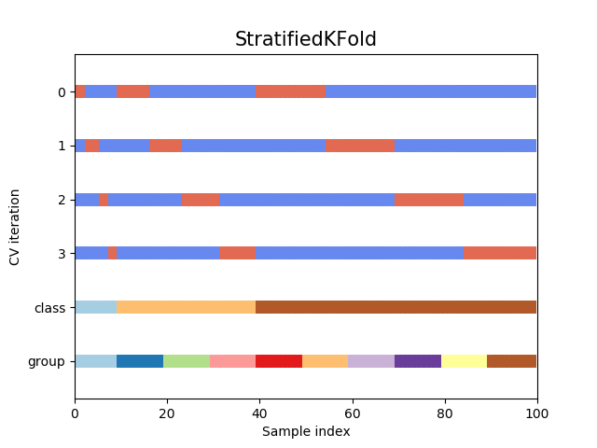
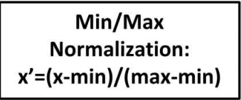
Final Combination for Sensitivity Analysis
Stratification is the process of rearranging the data as to ensure each fold is a good representative of the whole.
MinMaxScaler helps to transform the data set such that all the feature come in the range of [0, 1]. However, this scaling compress all inliers in the narrow range [0, 0.005]. Since, the data has a lot of axis parallel patterns. Thereby, compressing them in the range of [0, 0.005] will not affect our predictions.

Slide 33
Sensitivity Analysis
FE Attempts v/s Model Errors | Decision Tree |  | Bagged Decision Tree |  | Random Forest |  | Boosted Decision Tree |  | Bagged RG Decision Tree
 | Bias Error | Variance Error | Bias Error | Variance Error | Bias Error | Variance Error | Bias Error | Variance Error | Bias Error | Variance Error
After Dropping Soil Types Feature | 0.066128 | 0.001076 | 0.04003 | 0.000855 | 0.056923 | 0.000913 | 0.066296 | 0.001069 | 0.275507 | 0.003302
After FE of Hillshade mean | 0.054947 | 0.000657 | 0.034846 | 0.000783 | 0.047496 | 0.00131 | 0.054944 | 0.000625 | 0.268914 | 0.001695
After FE of Cos of Slope | 0.055971 | 0.000279 | 0.032098 | 0.000913 | 0.053805 | 0 | 0.055959 | 0.053192 | 0.270055 | 0.001804
After FE Sum & Difference of Distances | 0.048045 | 0.000202 | 0.029836 | 0.000625 | 0.034292 | 0.000493 | 0.048137 | 0.000202 | 0.265526 | 0.002274
After Multipli of Hillshade Index | 0.057205 | 0.000398 | 0.035922 | 0.000659 | 0.057181 | 0.001112 | 0.057181 | 0.000646 | 0.268643 | 0.003075
After Binning Soil Types + Soil Families | 0.057369 | 0.036171 | 0.036171 | 0.000565 | 0.044273 | 0.000933 | 0.057116 | 0.000916 | 0.263831 | 0.001377
Note: Bias Error is the complement of average precision scores (weighted) and the variance error is the spread of precision scores (weighted) for our models.

Slide 34
Sensitivity Analysis Results
AIM: To understand which model best reduces the sensitivity towards unknown test data in terms of predictions is giving best result.
Results:
Here we get a reasonable precision scores(weighted) with the Sums and Differences with various combinations of Horizontal Distances.
Since we had decided to focus on precision scores (weighted) for our model evaluation, Stratified K-fold with MinMax Scaling and Bagged Decision Tree Model with max depth as 7 and n_estimators as 10 is the overall best modeling combination as of now we’ve seen so far for predicting the forest cover type with Forest_Cover_type_designation being the target variable when our metric chosen was precision scores (weighted).

Slide 35
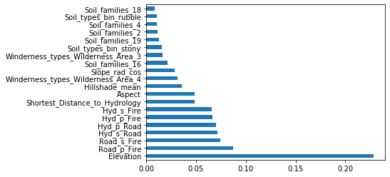
Random Forest Feature Importance

Slide 36
Final Features Used with Min Max Scaling
'Elevation'
'Aspect'
'Winderness_types'
'Road_p_Fire'
'Road_s_Fire'
'Hyd_s_Fire'
'Hyd_p_Fire'
'Hyd_p_Road'
'Hyd_s_Road'
'Shortest_Distance_to_Hydrology'
'Slope_rad_cos'
'Hillshade_mean'
'Soil_families'
'Soil_types_bin'
precision recall f1-score support
1 0.68 0.71 0.69 42333
2 0.74 0.77 0.76 56732
3 0.70 0.77 0.73 7058
4 0.57 0.62 0.59 595
5 0.48 0.20 0.29 1875
6 0.56 0.21 0.30 3503
7 0.76 0.38 0.51 4107
accuracy 0.71 116203
macro avg 0.64 0.52 0.55 116203
weighted avg 0.71 0.71 0.70 116203
Classification Report
Cohen Kappa Score: 0.55

Slide 37
Presented By:
Aashna Gutgutia
Dheeraj Ohl
Salil Trehan
Shubham Prakash

